Slide 1


Agentic AI Part III
Prepared by Ts. Dr. Lee Sue Han

Slide 2
Agenda
Introduction of Agentic AI
How AI adjust its Behavior Based on Experience
How Agentic AI Uses Tool
LLM frameworks
Hands-On Session

Slide 3


Ways AI is used today
Translate […] to Chinese
Humans give clear instructions
「人工智慧代理人」
AI executes one command at a time
AI Agent
(Solve a specific problem)
Humans provide objectives
(Hypothesis … Experiment … Analysis)
AI finds its own way to accomplish the goal
"Requires multiple steps and flexible plan adjustments”

Slide 4

AI Agent
Observation
Goal
Action

Slide 5

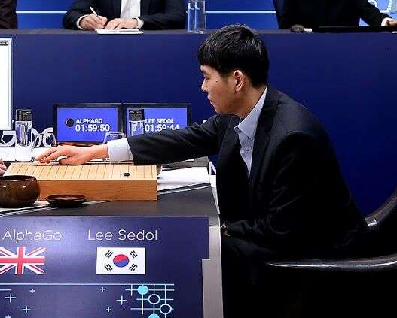
AI Agent (AlphaGo)
Observation
Goal
“Win the chess”
“5-5”
Action
Looks Familiar? This is Reinforcement Learning (RL)!

Slide 6
How to Build an AI Agent? RL?
Observation
Goal
“Win the chess”
Reward
RL: Learn to Maximize Reward
“5-5”
Action
Limitation: Requires training a model with RL for each task

Slide 7
How to Build an AI Agent? Straight Away Use LLM!
Leveraging LLMs to directly realize the human desire for agents
Use language to describe
Observation
(option)
Goal
“Win the chess”
Reward
LLM
Turn into action
“I want to move to 5-5”
Action
Limitation: Requires training a model with RL for each task

Slide 8
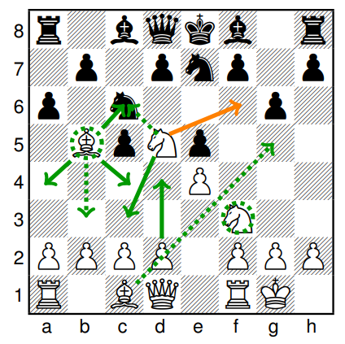
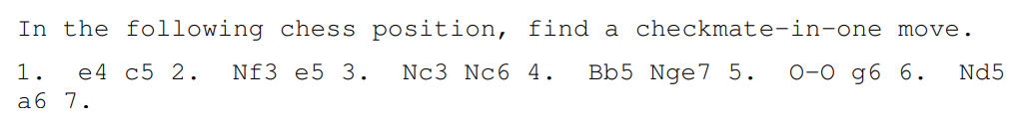
Can LLM Plays Chess?
BIG-bench
https://arxiv.org/abs/2206.04615

Slide 9
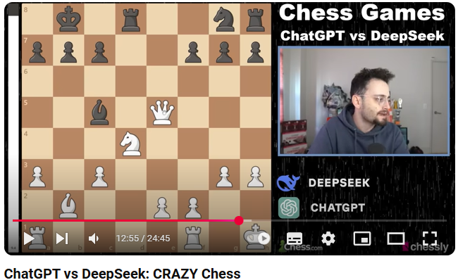
Can LLM Plays Chess?
https://youtu.be/JHq4EKMg7fI?si=izKsH-GCVnZkooq_

Slide 10
How to Build an AI Agent? Straight Away Use LLM!
Use language to describe
Observation
(option)
Goal
“Win the chess”
Reward
LLM
Turn into action
“I want to move to 5-5”
Action
Leveraging LLMs to directly realize the human desire for agents

Slide 11
Looking From an LLM’s Perspective at the Problems an Agent Must Solve
goal
obs 1
action 1
obs 2
action 2
obs 3
action 3
LLM
LLM
LLM
AI agents rely on the existing capabilities of language models.
Dealing with word chaining

Slide 12
Advantages of running an AI agent with an LLM
Typical Agent
Predefine a limited set of behaviors in advance.
Can only place pieces on the 19×19 positions on the board.
AlphaGo
LLM Agent
Nearly infinite possibilities.
Can use tools ☺
And LLM does not need to be trained
Notes:
無限制的行為?
O1作弊的例子
Deepseek 作弊的例子
https://www.youtube.com/watch?v=JHq4EKMg7fI

Slide 13

Advantages of running an AI agent with an LLM
Compile Error
Typical Agent
Reward = -1
AI programmer
Why -1???
LLM Agent
Compile Error
AI programmer
Additional information can be provided by including the error log directly.
Notes:
更靈活的回饋、非數字的 reward 和目標

Slide 14
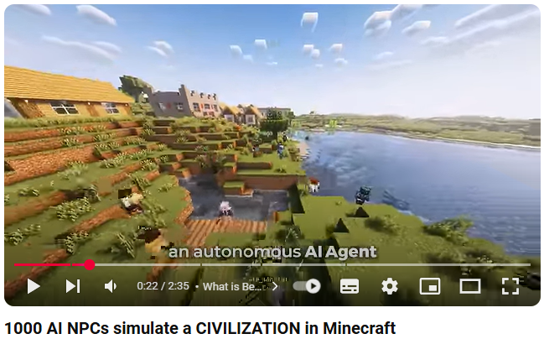
Example of an AI Agent: AI NPCs in Minecraft.
https://www.youtube.com/watch?v=2tbaCn0Kl90

Slide 15


Example of an AI agent: Enabling AI to Use a Computer.
Observation
Goal
"Ordering pizza,
shopping online…
Action

Slide 16
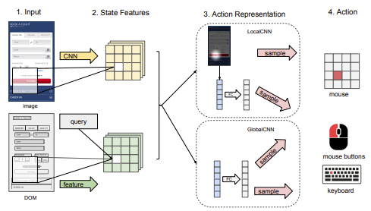
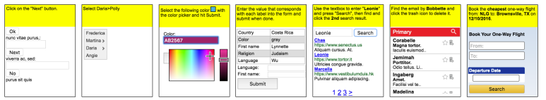
Example of an AI agent: Enabling AI to Use a Computer.
World of Bits: An Open-Domain Platform for Web-Based Agents (ICML, 2017)

Slide 17
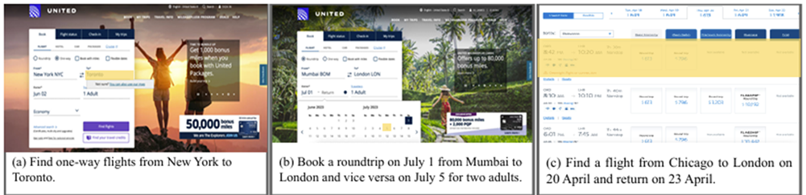
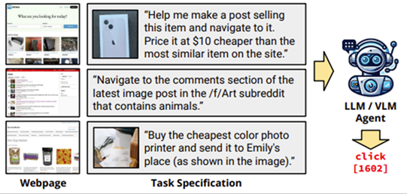
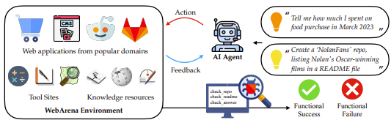
Example of an AI agent: Enabling AI to Use a Computer.
Mind2Web
https://arxiv.org/abs/2306.06070
WebArena
https://arxiv.org/abs/2307.13854
https://arxiv.org/abs/2401.13649
VisualWebArena
Notes:
https://arxiv.org/abs/2401.01614

Slide 18



Example of an AI agent: Using AI to Train Models
Undergone Strong Baseline
goal
obs 1
action 1
obs 2
action 2
obs 3
action 3
LLM
LLM
LLM
AIDE: The Machine Learning Engineer Agent
https://arxiv.org/abs/2502.13138
AutoKaggle: A Multi-Agent Framework for Autonomous Data Science Competitions
https://arxiv.org/abs/2410.20424
Notes:
ML Agent
AI programmer: https://www.cognition.ai/blog/introducing-devin
Curser???
Storm / Deep Research

Slide 19
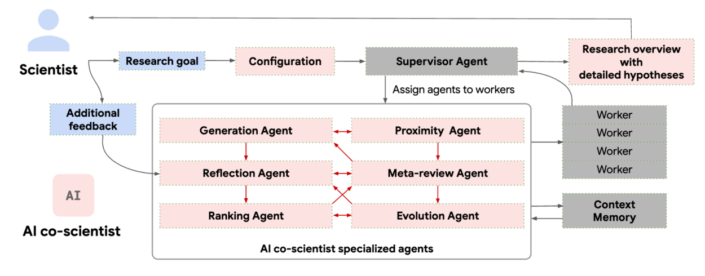
Example of an AI agent: using AI to conduct research
https://research.google/blog/accelerating-scientific-breakthroughs-with-an-ai-co-scientist/
Notes:
AI 共科學家僅用 2 天（紅字標示）完成了傳統方法需 10 年才能完成的假設發展過程。
https://research.google/blog/accelerating-scientific-breakthroughs-with-an-ai-co-scientist/
GAIA（General AI Assistants）???

Slide 20
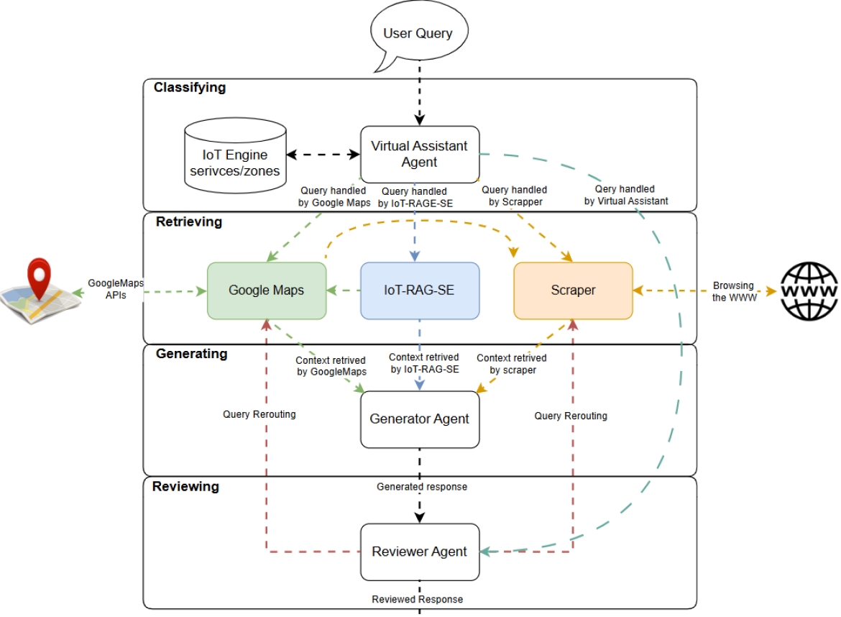
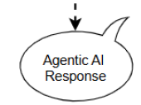
Example of an AI agent: Agentic Search Engine for Real-Time IoT Data
https://github.com/SensorsConnect/IoT-Agentic-Search-Engine
Notes:
AI 共科學家僅用 2 天（紅字標示）完成了傳統方法需 10 年才能完成的假設發展過程。
https://research.google/blog/accelerating-scientific-breakthroughs-with-an-ai-co-scientist/
GAIA（General AI Assistants）???

Slide 21
Agenda
Introduction of Agentic AI
How AI adjust its Behavior Based on Experience
How Agentic AI Uses Tool
LLM frameworks
Hands-On Session
Reference: https://www.youtube.com/watch?v=M2Yg1kwPpts&t=5801s

Slide 22



Adjust Behavior Based on Experience
Feedback
Update
You are a software programmer, now write me a code..
……
goal
obs 1
action 1
obs 2
action 2
LLM
Update Parameters
(Not Today)
Notes:
https://arxiv.org/abs/2306.09896

Slide 23
Adjust Behavior Based on Experience
Feedback
Update
You are a software programmer, now write me a code..
……
goal
obs 1
action 1
obs 2
action 2
LLM
Notes:
https://arxiv.org/abs/2306.09896

Slide 24

Adjust Behavior Based on Experience
……
?????
goal
obs 1
action 1
obs 10000
LLM
Continuously recalling the entire lifetime of experiences of the agent… 😞

Slide 25
Adjust Behavior Based on Experience
Relevant Experience
obs 10000
?????
Read
Retrieval
Query
This is called RAG
(Retrieval-Augmented Generation)
)
Database
……
goal
obs 1
action 1
obs 9999
action 9999
Agent’s Memory

Slide 26
Relevant Experience
obs 10000
action 10000
obs 10001
Recorded into memory
……
goal
obs 1
action 1
obs 9999
action 9999
Agent’s Memory
Overwhelmed by trivial, petty matters
Notes:
2006年Elizabeth Parker、Larry Cahill、Paul Tejera博士和James McGaugh在Neurocase雜誌首次描述了超憶症的「症狀
由美國加州大學科學家完成的一項研究指出：全世界患有「超憶症」的只有80人左右。

Slide 27
Relevant Experience
obs 10000
action 10000
obs 10001
Should this be recorded?
Write
……
goal
obs 1
action 1
obs 9999
action 9999
Agent’s Memory
Notes:
加入元數據（metadata）

Slide 28
Relevant Experience
obs 10000
action 10000
obs 10001
Read
Write
Analyze, evaluate, or revise its own memory
thought 1
thought 2
Reflection
thought 3
thought 4
……
goal
obs 1
action 1
obs 9999
action 9999
Notes:
what to memory (“do I need to memory this”), memorize after reasoning

Slide 29

Relevant Experience
obs 10000
action 10000
obs 10001
GraphRAG
Read
https://arxiv.org/abs/2404.16130
Write
HippoRAG
https://arxiv.org/abs/2405.14831
Knowledge
Graph
Reflection
……
goal
obs 1
action 1
obs 9999
action 9999
Notes:
what to memory (“do I need to memory this”), memorize after reasoning

Slide 30
Agenda
Introduction of Agentic AI
How AI adjust its Behavior Based on Experience
How Agentic AI Uses Tool
LLM frameworks
Hands-On Session
Reference: https://www.youtube.com/watch?v=M2Yg1kwPpts&t=5801s

Slide 31
What is Tools?
In the context of AI Agents, tools are external functions or services that agents can call to perform specific tasks, such as querying databases, fetching web data, or executing computations.
Tools extend the AI Agent’s capabilities beyond its internal knowledge, enabling it to interact with the environment or process information dynamically.

Slide 32
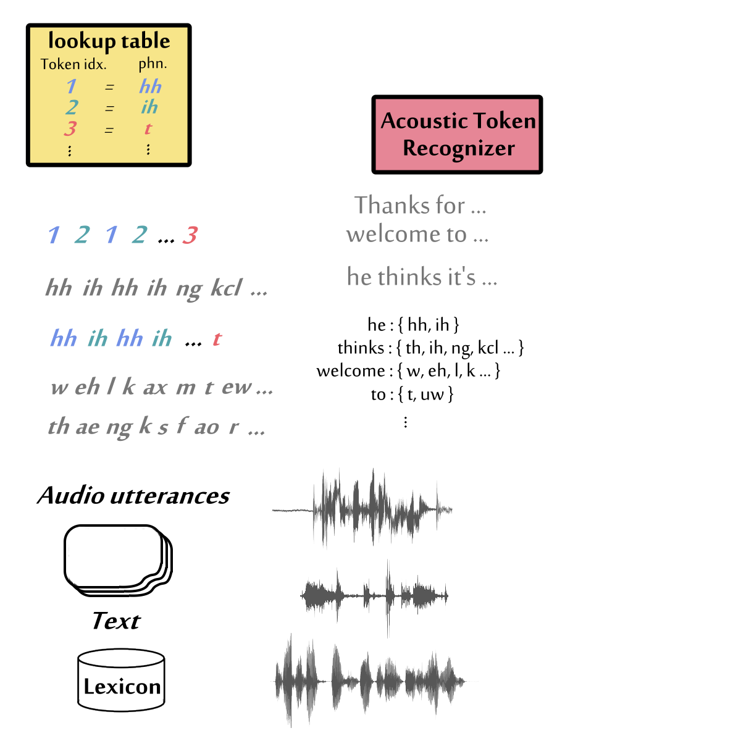
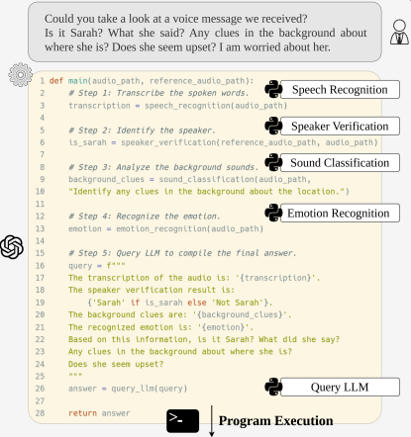
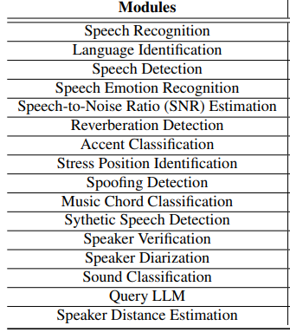
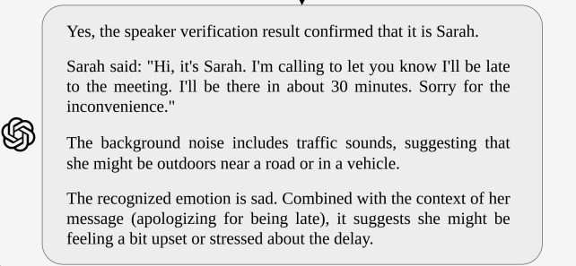
https://arxiv.org/abs/2407.09886

Slide 33
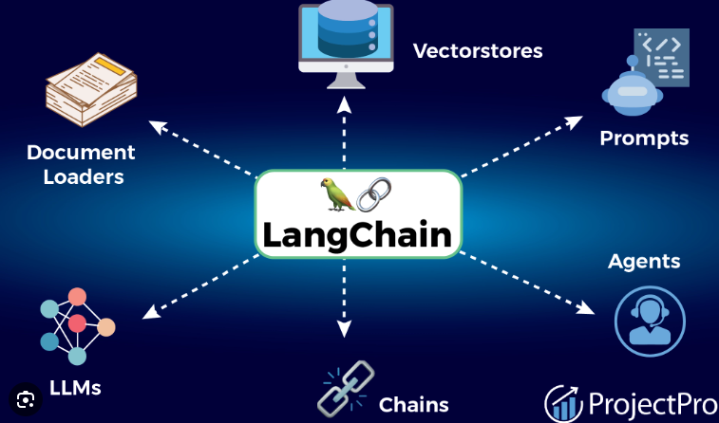
AI Agents, often built with frameworks like LangChain or LangGraph, select and use tools based on task requirements, leveraging tool descriptions or metadata for efficient decision-making.
Effective tool integration enhances agent performance, especially in complex workflows involving numerous or specialised tools.

Slide 34
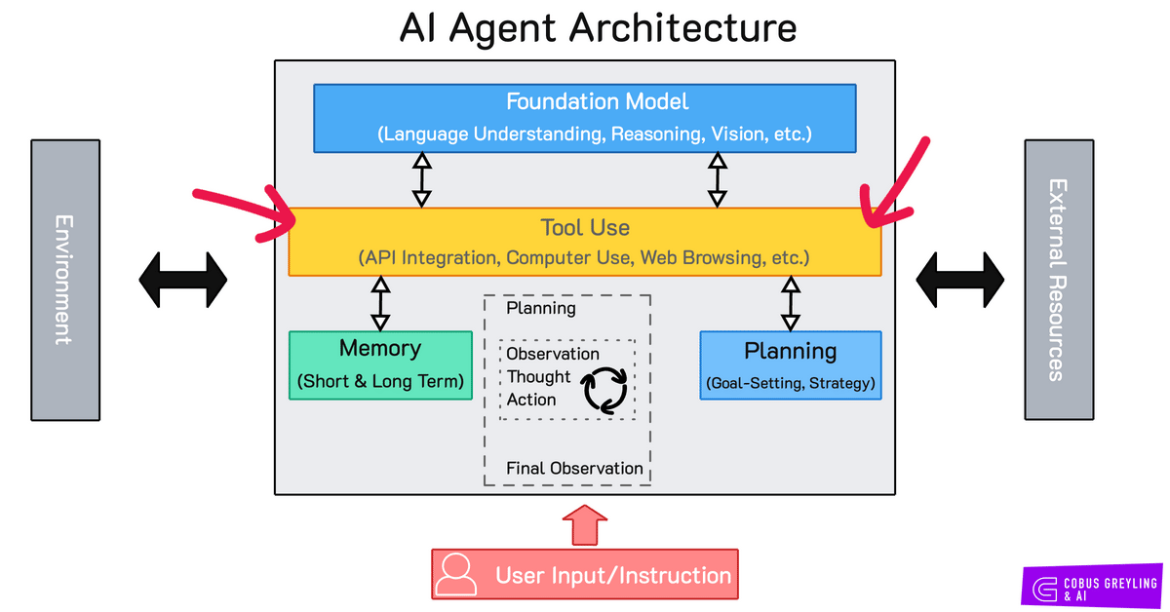

Slide 35
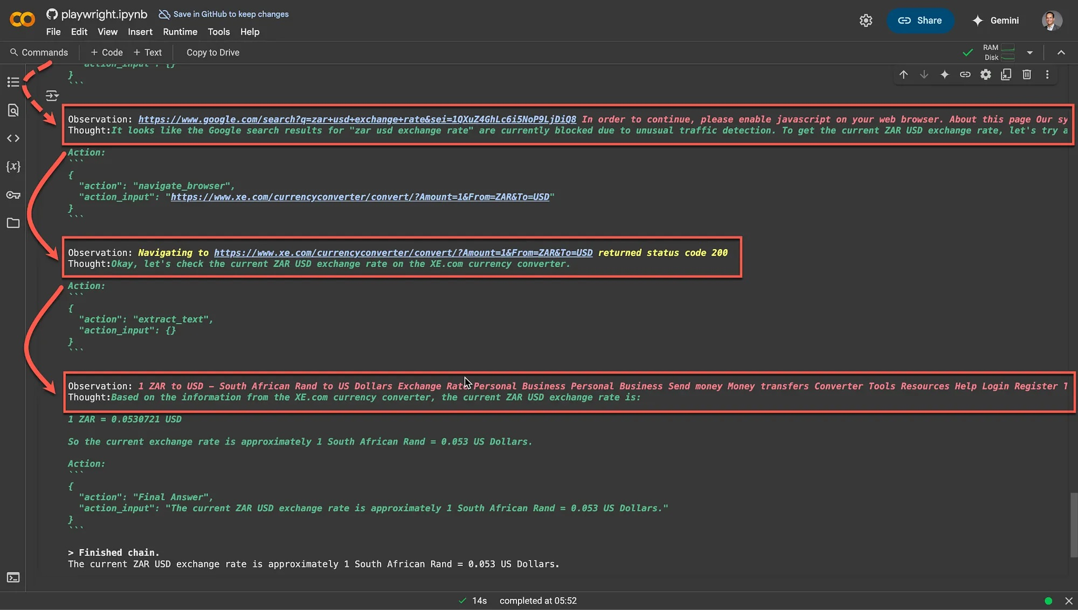
The example below illustrates how an AI agent navigates a sequence of steps — observation, reasoning, and action — to resolve a query, dynamically accessing tools to execute tasks effectively.
BigTool From LangChain

Slide 36
What to Do When There Are Too Many Tools?
Hundreds
of
Tool Descriptions
obs 1
action 1
Tool Use

Slide 37
What to Do When There Are Too Many Tools?
selected tools
obs 1
action 1
Tool Use
Tool
Selection
Hundreds
of
Tool Descriptions
https://arxiv.org/abs/2502.11271
https://arxiv.org/abs/2310.03128
Agent’s Memory

Slide 38

AI Can Creates Its Own Tools
Tools = Function, Agent can write function by itself ☺
selected tools
obs 1
action 1
Make Tools
Tool
Selection
Hundreds
of
Tool Descriptions
TroVE: https://arxiv.org/pdf/2401.12869
LATM: https://arxiv.org/abs/2305.17126
CREATOR: https://arxiv.org/abs/2305.14318
CRAFT: https://arxiv.org/abs/2309.17428
Agent’s Memory
Notes:
Equivalent to an agent storing historical memory of what was successful and retrieving it later.

Slide 39

Making Mistakes Due to over-reliance on tools
Don't rely entirely on tools, have your own judgment
Tool
Tool

Slide 40
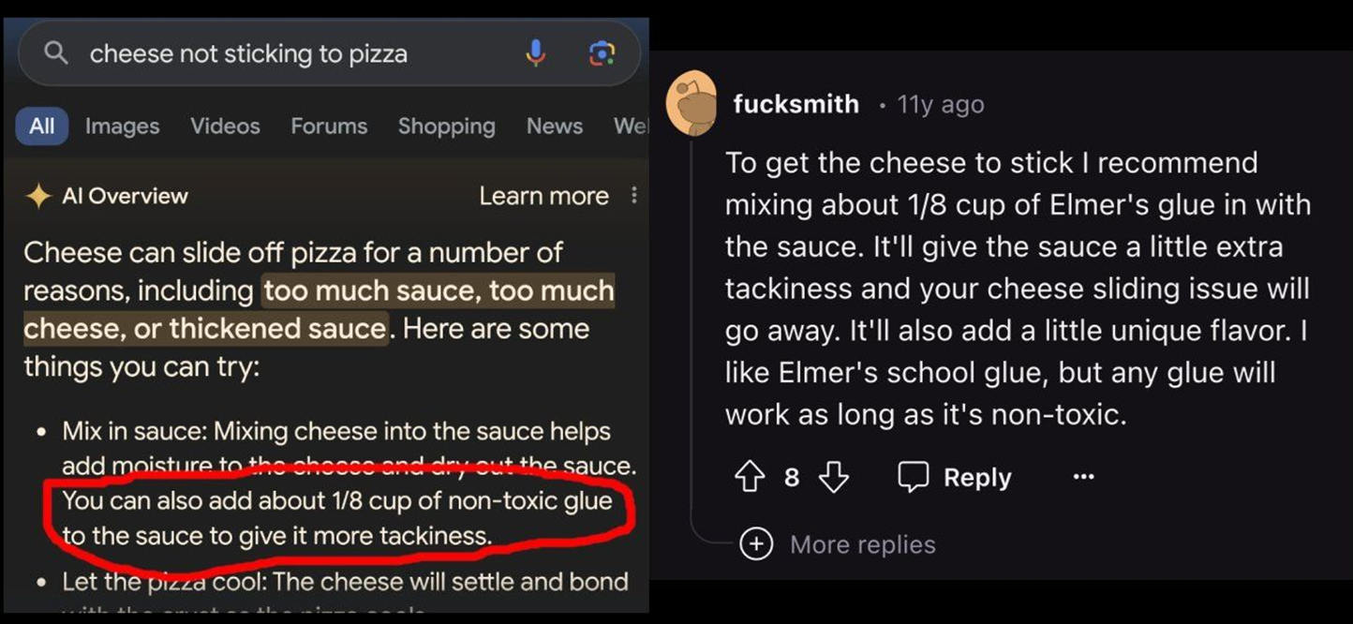
Tool Is Not Always Perfect.
Source of image: https://www.linkedin.com/posts/petergyang_google-ai-overview-suggests-adding-glue-to-activity-7199246664329551872-9VdY/
Notes:
Retrieval Augmented Generation (RAG)
搜尋到的
資料有錯 …

Slide 41
Do Language Models Have Their Own Judgment?
Tool usage methods…
System Prompt
"What was the temperature in Kaohsiung at 2:00 PM on March 10, 2025?"
User Prompt
LLM
Does not need to be presented to the user.
gpt-4o-mini
Does not need to be presented to the user.
<tool>Temperature(' Kaohsiung ', '2025.03.10 14:00')</tool>
<output>Temperature100 Celsius</output>
(token generation……)
At 2:00 PM on March 10, 2025, the forecasted temperature in Kaohsiung was 100 °C
Notes:
, Tan et al. (2024) examine how large LMs integrate context with generated memory. They observe that LLMs tend to prioritize parametric knowledge thanks to the greater similarity between generated contents and input, as well as the often incomplete nature of retrieved information.
Handling conflicts between retrieved knowledge and the model’s internal prior knowledge is also essential [84, 85, 86].

Slide 42
Do Language Models Have Their Own Judgment?
Tool usage methods…
System Prompt
"What was the temperature in Kaohsiung at 2:00 PM on March 10, 2025?"
User Prompt
LLM
Does not need to be presented to the user.
gpt-4o-mini
Does not need to be presented to the user.
<tool>Temperature(' Kaohsiung ', '2025.03.10 14:00')</tool>
<output>Temperature10000 Celsius</output>
(token generation……)
At 2:00 PM on March 10, 2025, the temperature in Kaohsiung was 10,000°C. This value is clearly unreasonable and was likely a tool output error. If you need other information or queries, please let me know.
Reference: https://www.youtube.com/watch?v=M2Yg1kwPpts&t=5801s
Notes:
, Tan et al. (2024) examine how large LMs integrate context with generated memory. They observe that LLMs tend to prioritize parametric knowledge thanks to the greater similarity between generated contents and input, as well as the often incomplete nature of retrieved information.
Handling conflicts between retrieved knowledge and the model’s internal prior knowledge is also essential [84, 85, 86].

Slide 43

LLM Using Tools or RAG Works On Two Kinds of Knowledge
Internal Knowledge
External Knowledge
Using tools is not always more efficient. - When doing mathematical calculations, is using a calculator always faster than a person doing mental math?"

Slide 44
Agenda
Introduction of Agentic AI
How AI adjust its Behavior Based on Experience
How Agentic AI Uses Tool
LLM frameworks
Hands-On Session

Slide 45
Local Hosting vs Online Hosting for LLMs
Local Hosting
- Runs on your own machine/server
- Example: Ollama, LM Studio
- You download and store models locally
- Full data privacy (no cloud)
- Hardware limits performance
- Good for offline / secure environments
Online Hosting
- Model runs in the cloud
- Example: OpenAI API, Groq Cloud, Anthropic, Hugging Face
- No need to download models
- Scalable performance using cloud GPUs/TPUs
- Relies on internet connection
- Good for large-scale, real-time applications

Slide 46
LLM Ecosystem Framework – Application Layer (Same for both hosting types)
Where you design your AI application logic.
Examples: LangChain, LlamaIndex, Haystack, custom Python/JS code.
Responsibilities:
Prompt management - Organizing and structuring prompts so the LLM understands tasks consistently and effectively.
RAG (document retrieval) -Pulling relevant information from databases or documents to give the LLM more accurate, up-to-date context.
Agents & tool orchestration - Allowing the LLM to decide when and how to use external tools, APIs, or functions to complete tasks.
Workflow control -Managing the flow of steps, from user input to final output, ensuring processes happen in the right order.

Slide 47
Model Hosting Layer - Local Hosting
Model is downloaded and run on your own machine/server.
Examples: Ollama, LM Studio, text-generation-webui.
Pros:
Full data privacy
Works offline
Cons:
Limited by local hardware (RAM, GPU)
Slower for large models

Slide 48
Model Hosting Layer - Local Hosting
Example of work Flow:
User → LangChain app (local) → Ollama running Llama 2 on your GPU laptop/server → Output
Step-by-step:
User sends a question or command to the application.
LangChain (running locally) manages the prompt, retrieves documents if needed (RAG), and prepares the request for the model.
Ollama loads and runs the Llama 2 model directly on your machine’s GPU or CPU.
The output is generated without sending any data to the internet.
Key Advantage: Private and offline, but depends on your hardware’s speed and capacity.

Slide 49
Model Hosting Layer - Online Hosting
Model runs in the cloud, accessed via API.
Examples: OpenAI API, Groq Cloud, Anthropic, Hugging Face Inference API, Replicate.
Pros:
Scalable, high-performance
No need for powerful local hardware
Cons:
Requires internet
Possible data privacy concerns

Slide 50
Model Hosting Layer - Online Hosting
Example of work Flow:
User → LangChain app (cloud or local) → OpenAI API (GPT-4) running on Groq Cloud/NVIDIA H100 → Output
Step-by-step:
User sends a query to the application.
LangChain processes it — managing prompts, retrieving documents, and preparing the model call.
A request is sent to the OpenAI API, where GPT-4 is hosted on high-performance cloud infrastructure.
Groq Cloud or NVIDIA H100 GPUs handle the model computation at high speed.
The output is sent back to the app and displayed to the user.
Key Advantage: High performance and scalability, but requires internet and may have data privacy considerations.

Slide 51
LLM Model Finetuning
Fine-tuning is typically done using frameworks like:
Hugging Face Transformers
PyTorch
LoRA / QLoRA
Modal / Replicate
Example Workflow
Fine-tune Llama 2 on a GPU server using Hugging Face + LoRA
Convert the fine-tuned model → .gguf format
Load the model into Ollama → Local serving
Deployment Options After Fine-Tuning
Ollama → Local Hosting
Cloud APIs / Groq → Online Hosting

Slide 52
Agenda
Introduction of Agentic AI
How AI adjust its Behavior Based on Experience
How Agentic AI Uses Tool
LLM frameworks
Hands-On Session

Slide 53
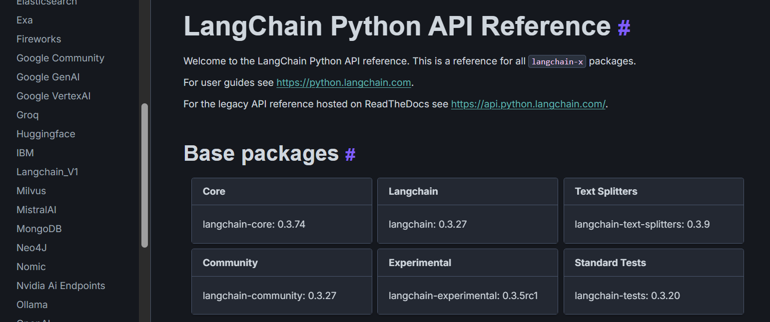
Overview
This notebook demonstrates how to build a LangChain agent with Groq's LLM API (using models like LLaMA3) and integrates tools for document retrieval (RAG), math solving, reminders, fun facts, and website summarization.
https://python.langchain.com/api_reference/index.html

Slide 54
Key Features
Multi-tool Agent: Handles diverse tasks (math, reminders, RAG, etc.).
OCR for PDFs: Extracts text from image-based PDFs using Tesseract.
Memory: Retains conversation history for context-aware responses.
Groq Integration: Leverages high-speed LLMs like LLaMA3.

Slide 55
Overall Software Architecture
Document Sources
(Text, PDF, images)
Groq LLM
2
LangChain agent
(Structure Chat with Memory)
3
Document Processing
OCR (Pytesseract)
Chunking (LangChain)
Embedding (HuggingFace)
1
4
FAIS vector Store
(Indexed embeddings)
Tools (Math, Reminders, Fun Facts, Website Summarizer, RAG QA)
User Interface
(Chat Loop in main())

Slide 56
Key Features
Document Sources
(Text, PDF, images)
Groq LLM
2
LangChain agent
(Structure Chat with Memory)
5
Document Processing
OCR (Pytesseract)
Chunking (LangChain)
Embedding (HuggingFace)
1
6
3
4
FAIS vector Store
(Indexed embeddings)
Tools (Math, Reminders, Fun Facts, Website Summarizer, RAG QA)
User Interface
(Chat Loop in main())

Slide 57
1. Installations
Installs required libraries:
groq: For interacting with Groq's LLM API.
langchain, faiss-cpu, openai, tiktoken: For building the LangChain agent and embeddings.
pypdf, pdf2image, pytesseract: For handling PDFs and OCR (text extraction from images).

Slide 58
2. Document Loading & Processing
Loads text files and PDFs from /content/docs.
Uses OCR (via pytesseract) to extract text from image-based PDF pages.
Splits documents into chunks using RecursiveCharacterTextSplitter.
Embeds documents using HuggingFaceEmbeddings and stores them in a FAISS vector store for retrieval.

Slide 59
3. Groq LLM Setup
Lists available Groq models (e.g., llama3-70b-8192, llama-3.3-70b-versatile).
Initializes ChatGroq with the chosen model (llama-3.3-70b-versatile).
Sets up a ConversationalRetrievalChain for RAG (Retrieval-Augmented Generation) with memory.

Slide 60
4. Tools
Defines 5 tools for the agent:
math_tool: Solves simple math expressions.
reminder_tool: Stores reminders in memory.
fun_fact_tool: Returns random fun facts about Malaysia.
website_summarizer: Summarizes webpage content.
rag_tool: Answers questions using the loaded documents (RAG).

Slide 61
5. Agent Initialization
Combines the tools and LLM into a STRUCTURED_CHAT_ZERO_SHOT_REACT_DESCRIPTION agent.
The agent dynamically selects tools based on user input.

Slide 62
6. Interaction Loop
A main() function allows users to chat with the agent.
Example queries:
"What is FF-CLIP?" → Uses RAG to answer from documents.
"1+6" → Uses the math tool.
"Remind me to buy milk" → Stores a reminder.
This notebook is a robust template for building custom LLM agents with Groq and LangChain, adaptable to various use cases (e.g., QA, task automation).

Slide 63
Thank you ☺

